Slide 1
DIGITAL PORTFOLIO
STUDENT NAME:VIGNESH K
ROLL NO AND NMID:asanm10824131081802521082
DEPARTMENT: COMPUTER SCIENCE
COLLEGE/UNIVERSITY:TKGAC/ANNAMALAI UNIVERSITY

Slide 2
PROJECT TITLE
CREATE A STUDENT PORTFOLIO

Slide 3
AGENDA
• PROBLEM STATEMENT • PROJECT OVERVIEW • END USERS • TOOLS AND TECNOLOGIES • FEATURES AND FUNTIONALITY • RESULTS AND SCREENSHOTS • SCREENSHOT • CONCLUSION

Slide 4
PROBLEM STATEMENT
Students face difficulty in showcasing projects using plain resumes. Traditional CVs don’t highlight real technical skills effectively. Recruiters cannot judge creativity with text alone. A portfolio website gives a better interactive experience.

Slide 5
PROJECT OVERVIEW
This project is a Digital Portfolio Website for students and professionals.It highlights skills, projects, and achievements in an interactive way.The portfolio is fully responsive and works on all devices.It serves as a bridge between resumes and real-world work samples.

Slide 6
END USERS
Students can showcase their talents and projects effectively. Recruiters can evaluate candidates with live project demonstrations. Colleges can use it to track and present student achievements. Freelancers can impress clients by showing real-time portfolio work.

Slide 7
TOOLS AND TECNOLOGIES
Frontend: HTML5, CSS3, JavaScript for structure and styling.Frameworks: React.js / Bootstrap for modern UI design.Backend (optional): Node.js & Express with MongoDB database.

Slide 8
RESULTS AND SCREENSHOTS
THE FINISHED PORTFOLIO PROVIDES A PROFESSIONAL YET ATTRACTIVE REPRESENTAION FO A STUDENT IDENTITY

Slide 9
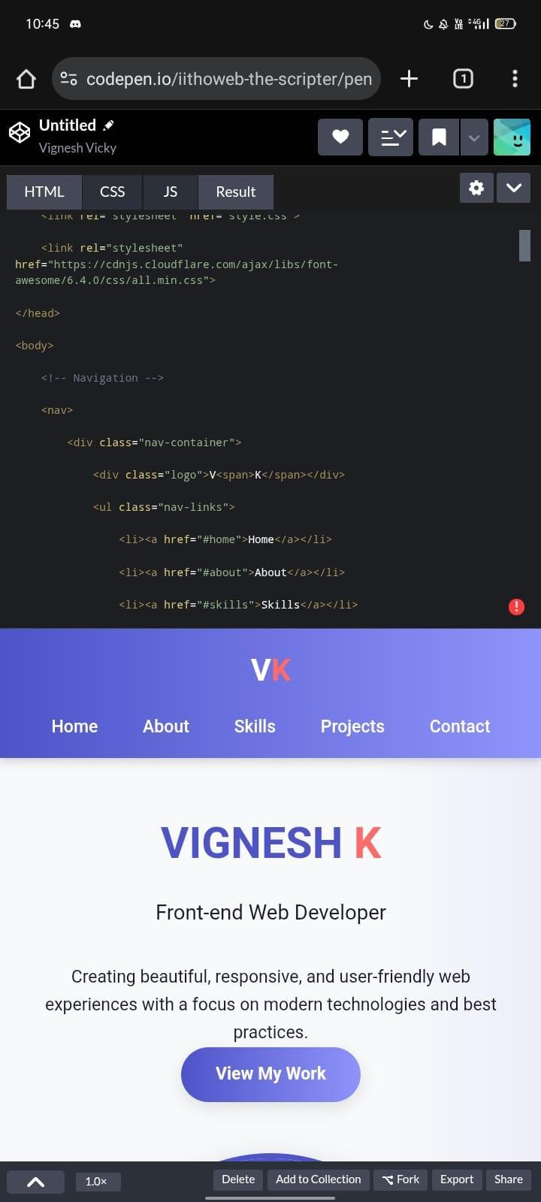
SCREENSHOT

Slide 10
CONCLUSION
THE PROJECT PROVES HOW A DIGITAL PORTFOLIO CAN SERVE AS A PERSONAL BRAND FOR STUDENTS .IT NOT ONLY HELPS IN ACADEMICS AND CAREER GROWTH BUT ALSO BIULS CONFISENCE BY PRESENTIND THE STRUCTURE.

